Slide 1

Single Sign-On with OpenID Connect
WSO2 Identity Server Fundamentals

Slide 2

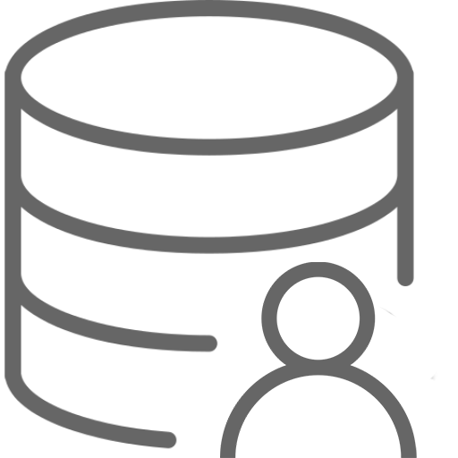






What is Single Sign-On?
Sign in to one application and gain access to all the other applications sharing the same session
Userstore
1
HR Application
2
Identity Provider (IdP)
WSO2 Identity Server
Accounts Application
Application User
[John Doe]
3
Sales Application

Slide 3
What is OpenID Connect (OIDC)
OpenID Connect 1.0 is a simple identity layer on top of the OAuth 2.0 protocol. It allows Clients to verify the identity of the End-User based on the authentication performed by an Authorization Server, as well as to obtain basic profile information about the End-User in an interoperable and REST-like manner.
Reference: https://openid.net/connect/

Slide 4


OAuth 2.0 Based Authentication
What’s missing in OAuth 2.0?
1. Authentication Request
Client
Application
[WordPress]
Resource
Owner
2. Authorization Request
[John Doe]
4. Access Token
User Information ?
3. Authentication + Consent
Authorization
Server
[WSO2 Identity Server]

Slide 5
OAuth 2.0 vs. OIDC
Authentication flow
1. Authentication Request
Client
Application
[WordPress]
Resource
Owner
2. Authorization Request
+
Scope=openid
[John Doe]
4. Access Token
ID Token
3. Authentication + Consent
Authorization
Server
[WSO2 Identity Server]

Slide 6
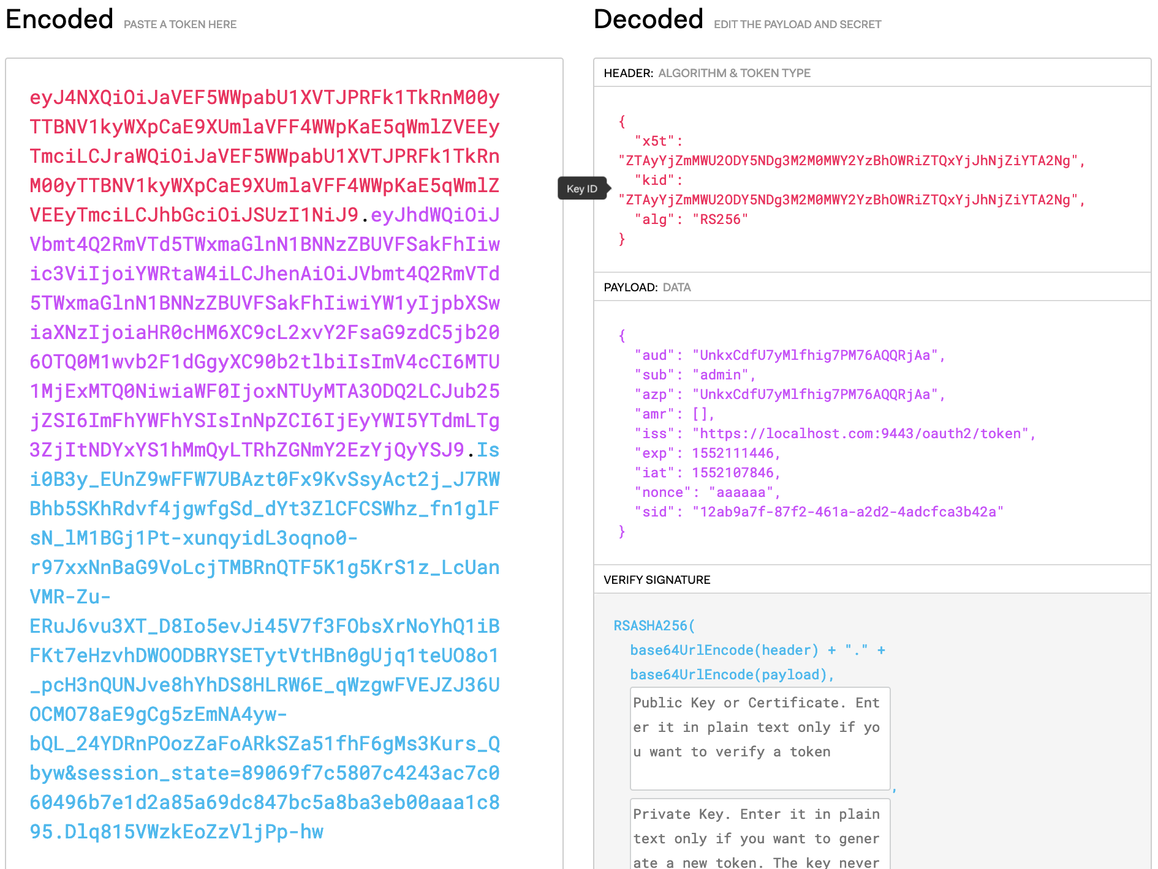
ID Token Format
Header
Body/Payload
  iss: issuer identifier
  sub: subject identifier
  aud: audience(s) that this ID Token is intended for
  exp: the expiration time
  iat: the token issued time
Signature

Slide 7
Identity Layer
Who is the user who got authenticated?
Where was the user authenticated?
When was the user authenticated?
How was the user authenticated?
What attributes the user can give you

Slide 8
Authorization Flows
Authorization Code
Implicit
Hybrid

Slide 9
OIDC Specifications
Core – Defines the core OpenID Connect functionality
Discovery – Defines how Clients dynamically discover information about OpenID Providers
Dynamic Registration – Defines how clients dynamically register with OpenID Providers
Session Management – Defines how to manage OpenID Connect sessions
Front-Channel Logout – Defines a front-channel logout mechanism
Back-Channel Logout – Defines a logout mechanism that uses direct back-channel communication between the OP and RPs being logged out

Slide 10
Quick Recap

Slide 11

About Single Sign-On (SSO)
What’s missing in OAuth2
ID token and identity layer
Authorization flows
What you learnt

Slide 12



Any Questions ?
Reach us through the following channels
iam-dev@wso2.org
https://stackoverflow.com/questions/tagged/wso2-identity-server
https://discord.com/invite/Xa5VubmThw

Slide 13
Thank you!
Notes:
Acknowledge that it’s been a lot of changes within the team
Thank you for your taking onboard the feedback and being open to change.
A lot of work , a lot of learning, sometimes feeling twice the exhaustion
But also hopefully seeing what I see, which is: better ways of working, more innovation in our approach, more business acumen, more effective reactivity , more ahead of the game. Because that’s where marketing needs to be.
All this in a context where it’s also been a lot of changes for WSO2.
And from this standpoint I wanted to remind you of what Sanjiva said about you owning the culture

